Slide 1
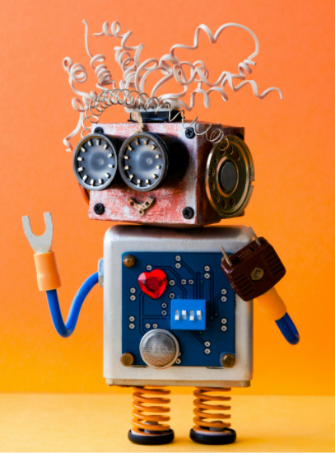
PROJECT CARD
EASY
ADVANCED

Slide 2

PROJECT CARD
GOAL:
Build, train, test and deploy an AI/ML model to predict which employees are more likely to quit based on their features.
TOOL:
AWS SageMaker Canvas
PRACTICAL REAL-WORLD APPLICATION:
This project can be effectively used in Human Resources Departments to predict employee attrition and understand key factors that contribute to it.
DATA:
INPUTS:
Job Involvement, Education, Job Satisfaction, Performance Rating, Relationship Satisfaction, Work Life Balance
OUTPUT:
Attrition (binary), i.e.: employee stayed or left
Image Source: https://publicdomainvectors.org/en/free-clipart/Employee-search-concept/83802.html
Dataset Source: https://www.kaggle.com/pavansubhasht/ibm-hr-analytics-attrition-dataset

Slide 3
INPUTS AND OUTPUTS
INPUTS
OUTPUT
ATTRITION
(0 or 1)
JOB INVOLVEMENT
EDUCATION
JOB SATISFACTION PERFORMANCE RATING
RELATIONSHIP SATISFACTION
WORK LIFE BALANCE
AI/ML MODEL

Slide 4
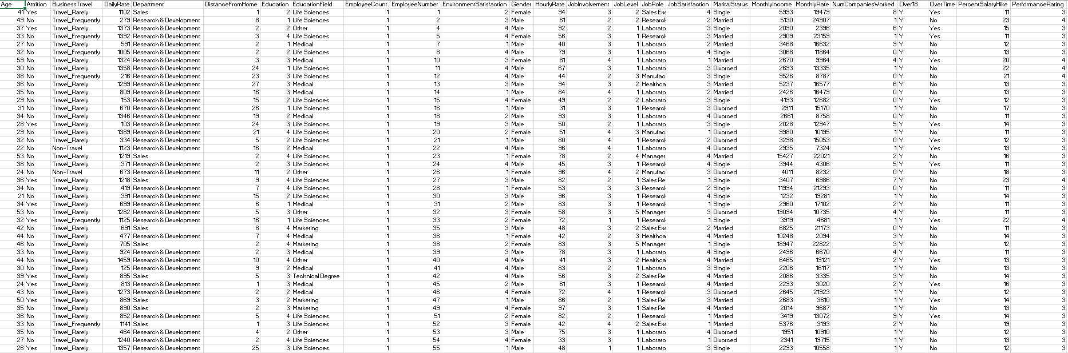
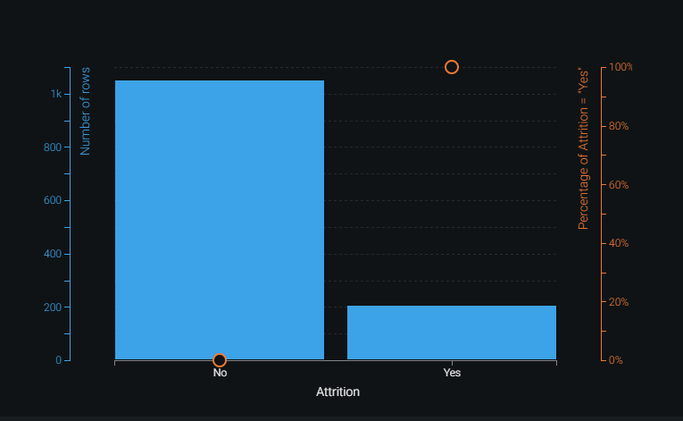
DATA OVERVIEW
MODEL OUTPUT: ATTRITION (BINARY VALUE) (YES OR NO)

Slide 5
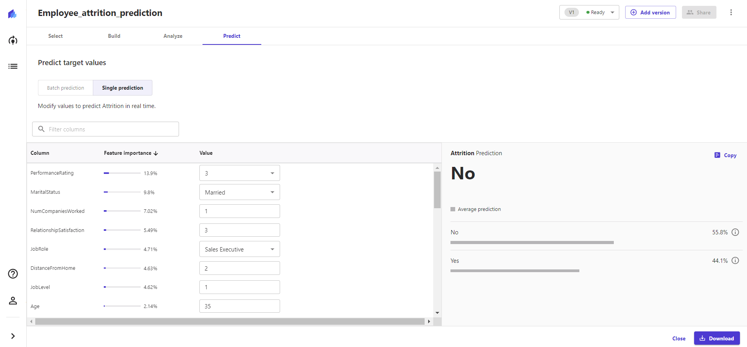
PROJECT DEMO

Slide 6
WHAT IS SAGEMAKER CANVAS?
EASY
ADVANCED

Slide 7
WHAT IS AWS SAGEMAKER CANVAS?
AWS SageMaker Canvas empowers anyone to build, train and test a machine learning model without writing a single line of code!
With AWS Canvas, anyone can:
Import data from S3 or any other source
Build an AI/ML model
Assess model performance
Perform inference and generate predictions
Export model to SageMaker Studio
AWS SageMaker Canvas Documentation:
https://aws.amazon.com/sagemaker/canvas/

Slide 8
SUCCESS STORIES
EASY
ADVANCED

Slide 9
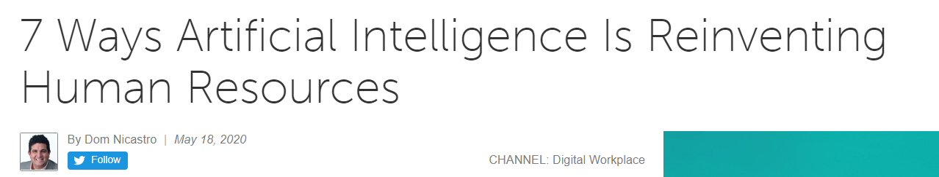
BUSINESS CASE AND SUCCESS STORIES
Hiring/retaining employees is an expensive process that requires capital, time and skills.
Average companies lose 1% - 2.5% of their total revenue on the time it takes to bring a new hire up to speed.
Companies spend 15%-20% of the employee's salary to recruit a new candidate.
7 ways AI is reinventing Human Resources: https://www.cmswire.com/digital-workplace/7-ways-artificial-intelligence-is-reinventing-human-resources/

Slide 10
BUSINESS CASE AND SUCCESS STORIES
EXTRACT INFORMATION FROM CANDIDATES RESUMES USING AI
ASSESS EMPLOYEE REFERRALS
GAIN KEY DATA INSIGHTS
IMPROVED ENGAGMENT USING AI-POWERED CHATBOTS
CUSTOMIZED LEARNING JOURNEY FOR EMPLOYEES
PREDICT EMPLOYEES' RETENTION, POTENTIAL AND FATIGUE
ENHANCED WORKPLACE ANALYTICS
https://www.cmswire.com/digital-workplace/7-ways-artificial-intelligence-is-reinventing-human-resources/

Slide 11


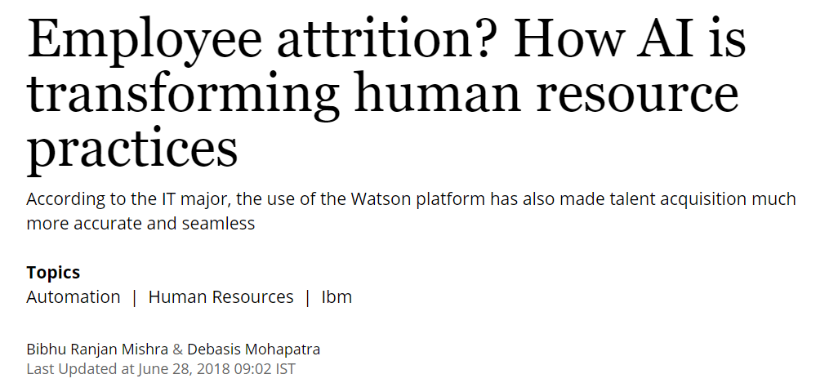
READING TIME & QUIZ – HOW AI IS TRANSFORMING HUMAN RESOURCES?
Please read the article below and answer the following quiz.
Link to Article: https://www.business-standard.com/article/jobs/employee-attrition-how-ai-is-transforming-human-resource-practices-118062701396_1.html
10 MINS
5 MINS

Slide 12
DEMO PART 1: LAUNCH CANVAS & UPLOAD DATA TO S3
EASY
ADVANCED

Slide 13
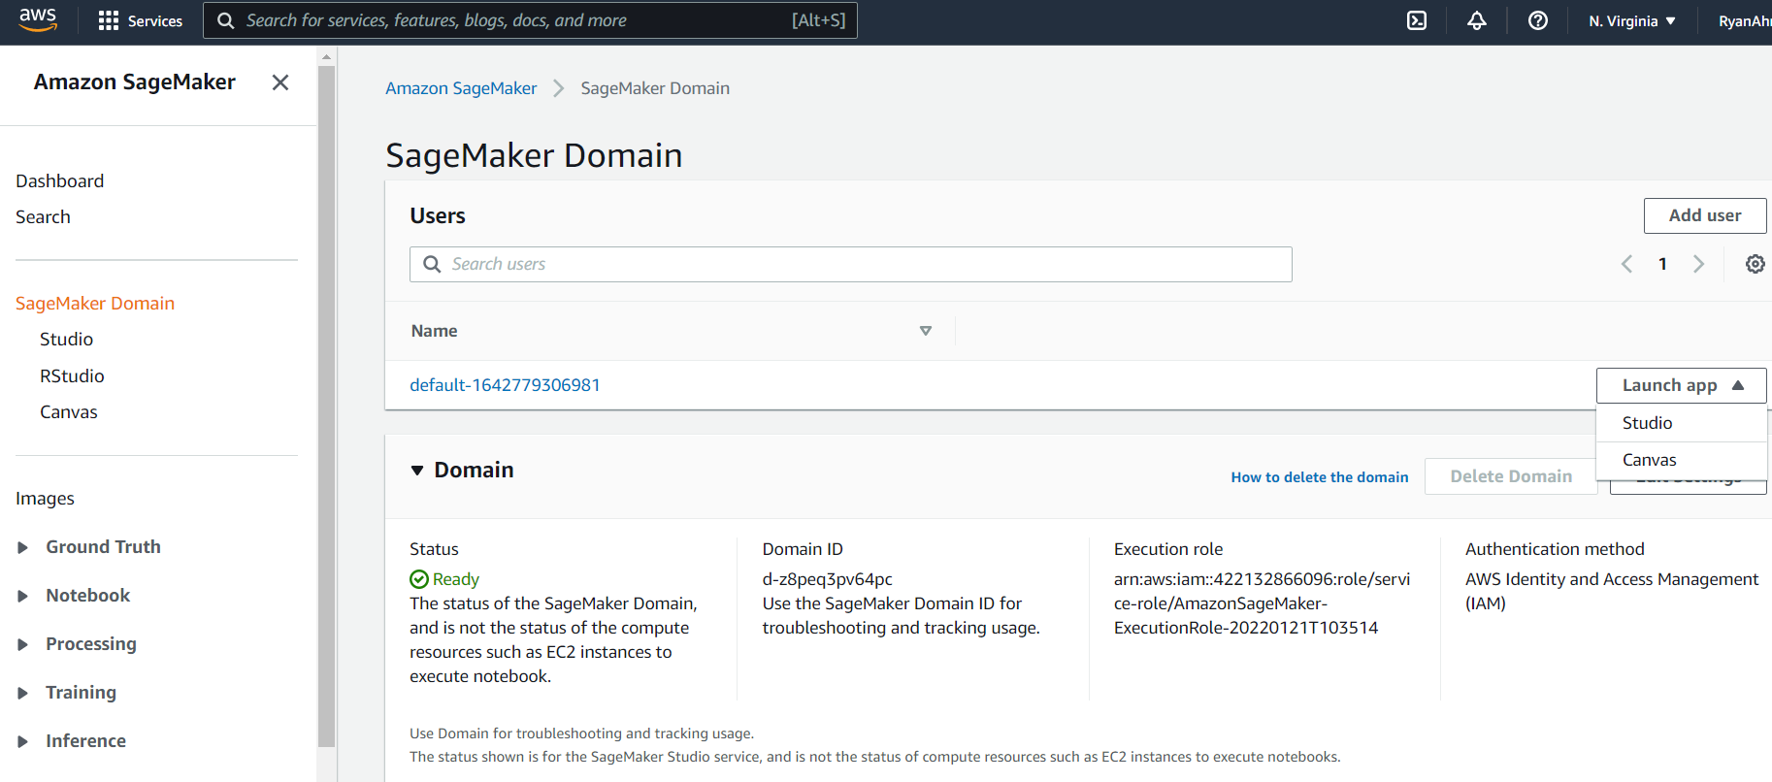
AWS SAGEMAKER CANVAS SETUP
AFTER CREATING A SAGEMAKER DOMAIN, CLICK ON LAUNCH APP AND THEN CANVAS

Slide 14
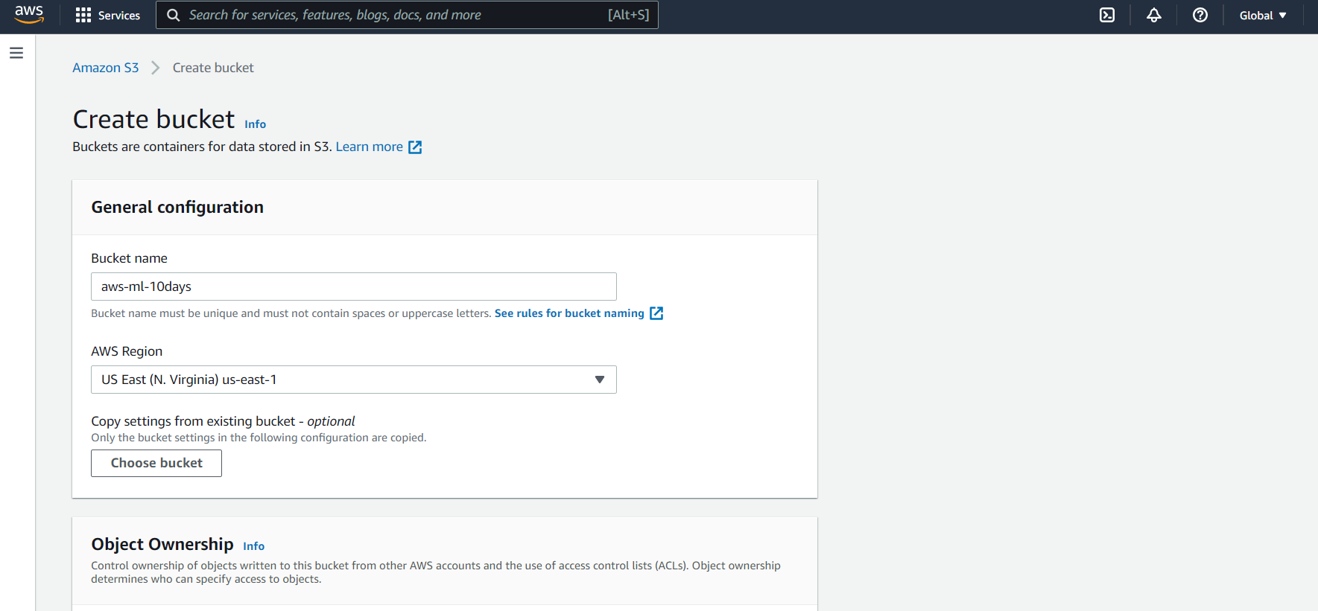
AWS SAGEMAKER CANVAS SETUP
CREATE A NEW S3 BUCKET BEFORE YOU LAUNCH THE AWS SAGEMAKER CANVAS

Slide 15
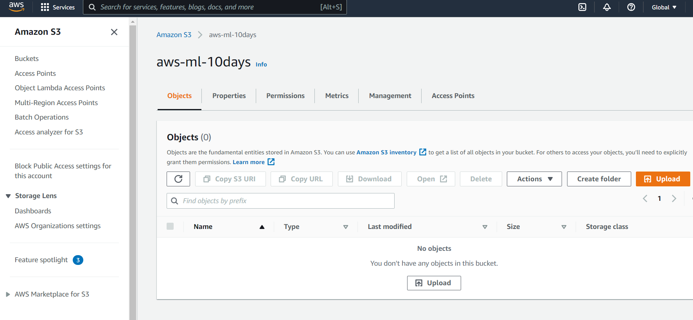
AWS SAGEMAKER CANVAS SETUP
UPLOAD THE DATA TO THE S3 BUCKET

Slide 16
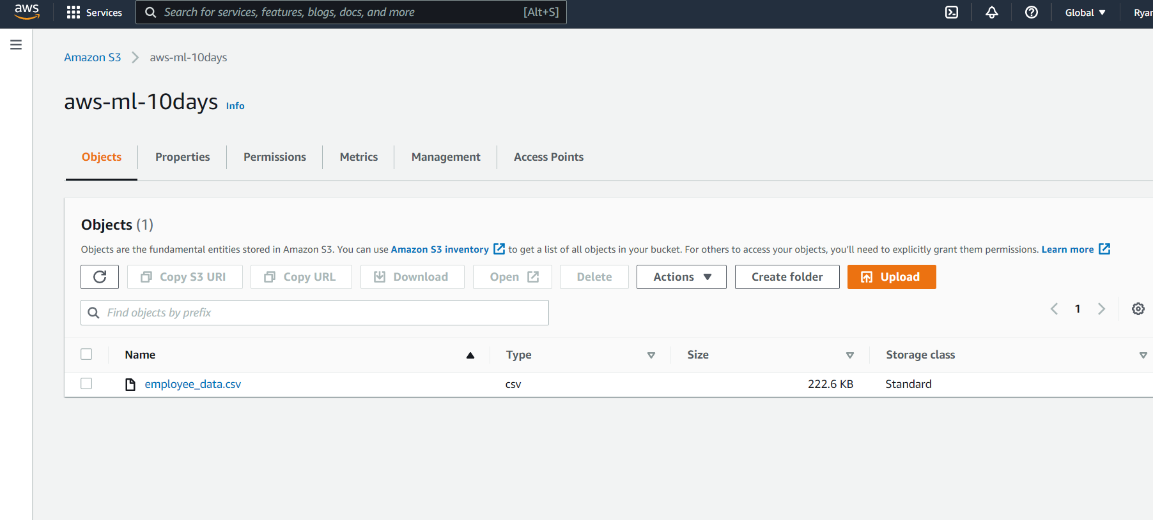
AWS SAGEMAKER CANVAS SETUP
EMPLOYEE_DATA.CSV IS NOW UPLOADED TO THE S3 BUCKET

Slide 17
DEMO PART 2: DATA IMPORT INTO CANVAS & MODEL TRAINING
EASY
ADVANCED

Slide 18
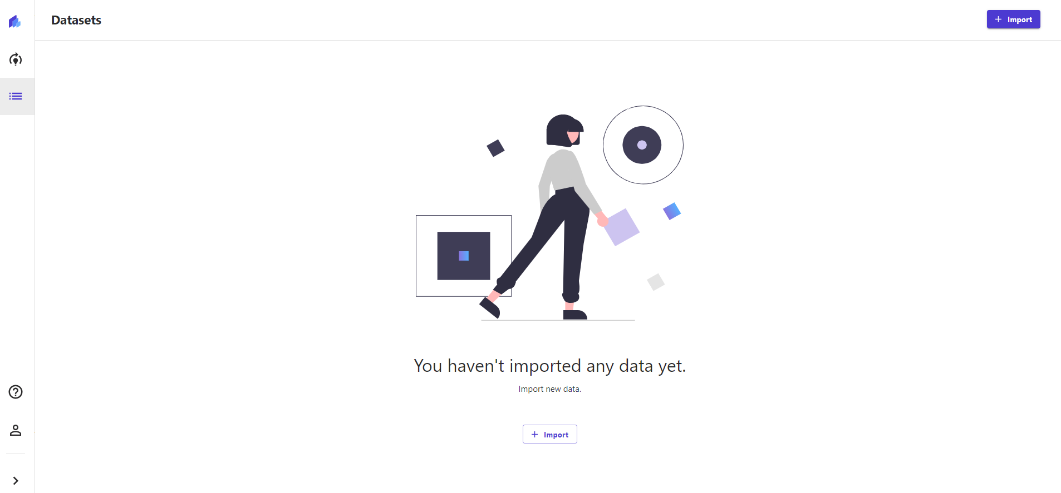
AWS SAGEMAKER CANVAS
FIRST YOU NEED TO IMPORT THE DATASET FROM S3, CLICK ON IMPORT

Slide 19
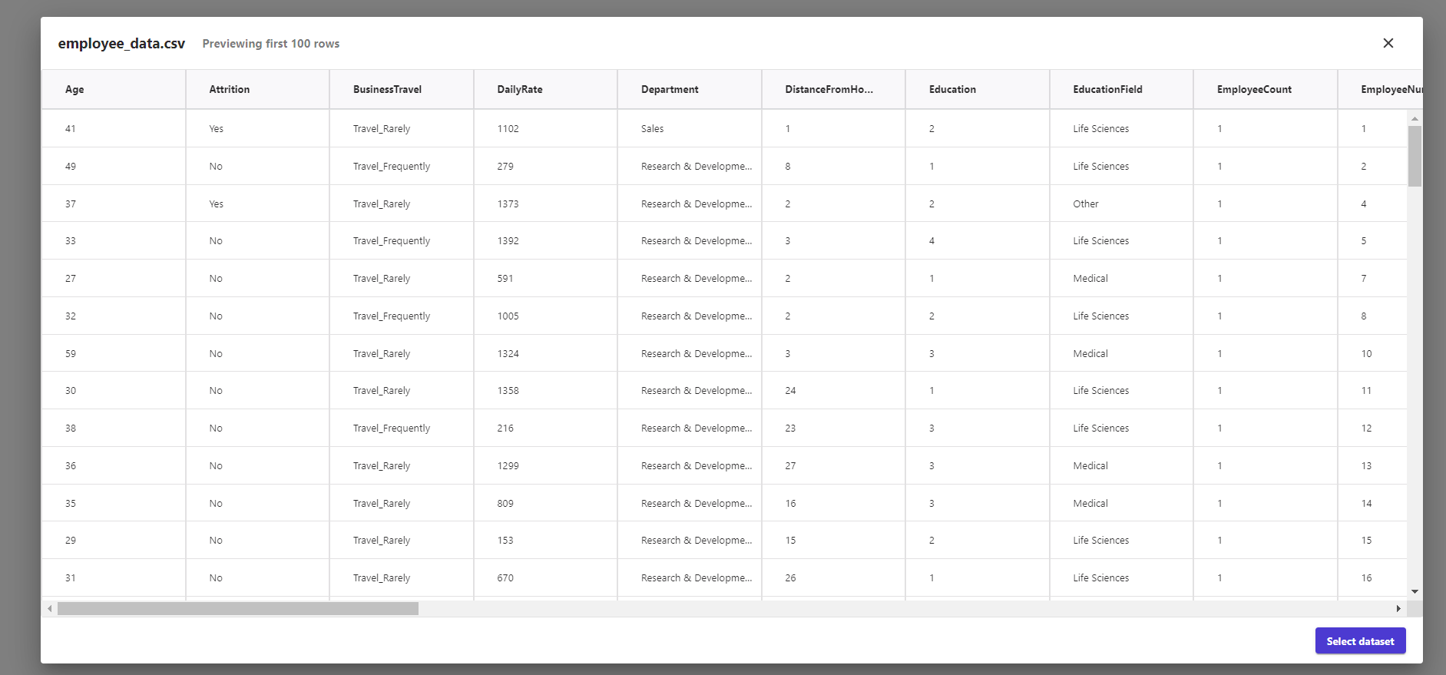
AWS SAGEMAKER CANVAS
SELECT THE BUCKET FROM S3. VIEW AND IMPORT THE DATASET

Slide 20
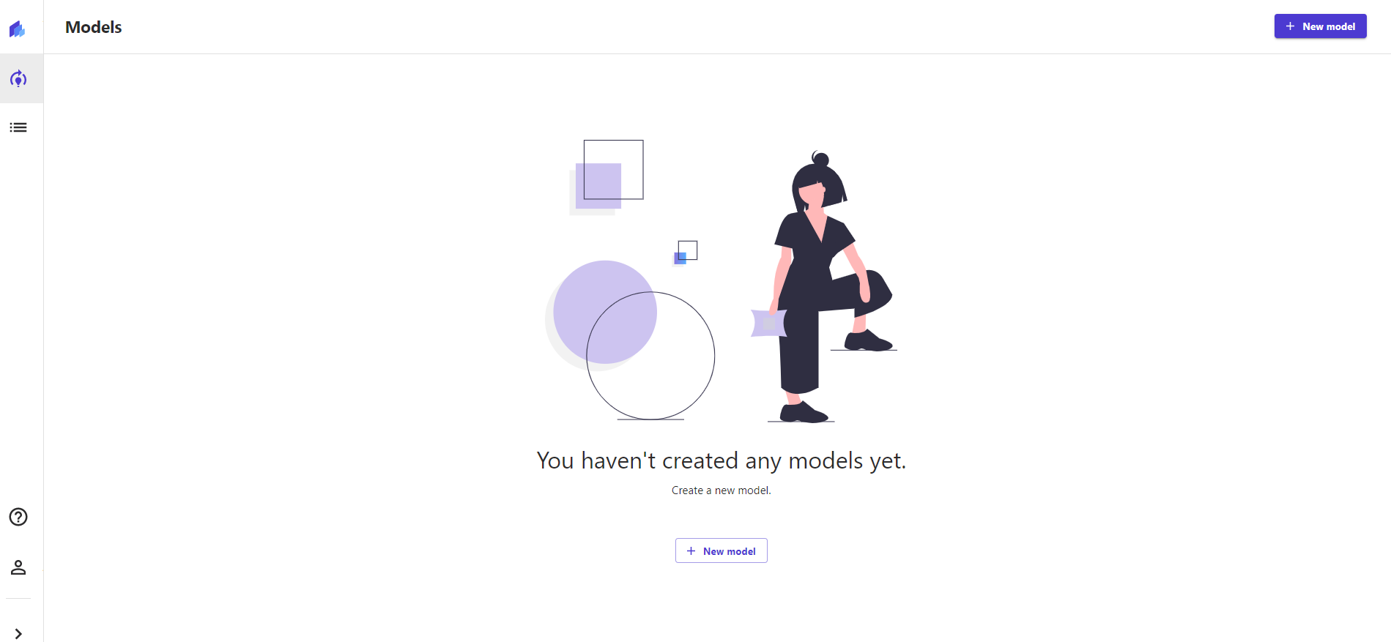
AWS SAGEMAKER CANVAS
CLICK ON MODELS AND CREATE A NEW MODEL AND CLICK CREATE

Slide 21
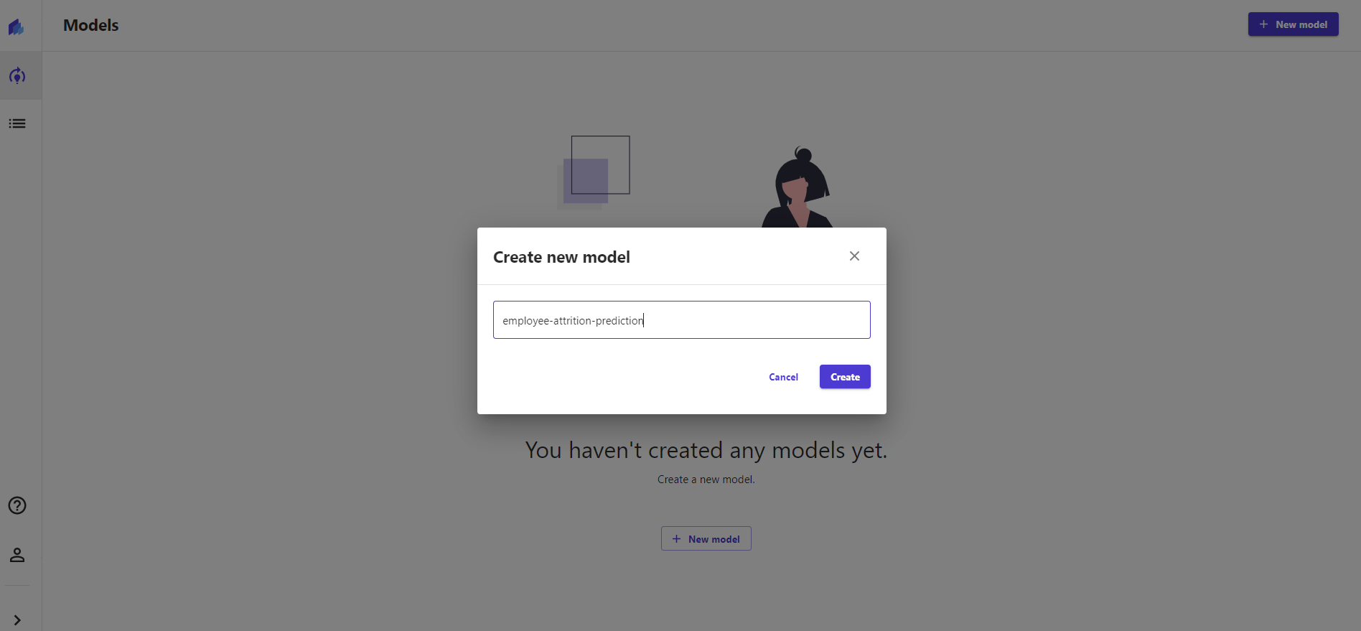
AWS SAGEMAKER CANVAS
GIVE A NAME TO THE MODEL

Slide 22
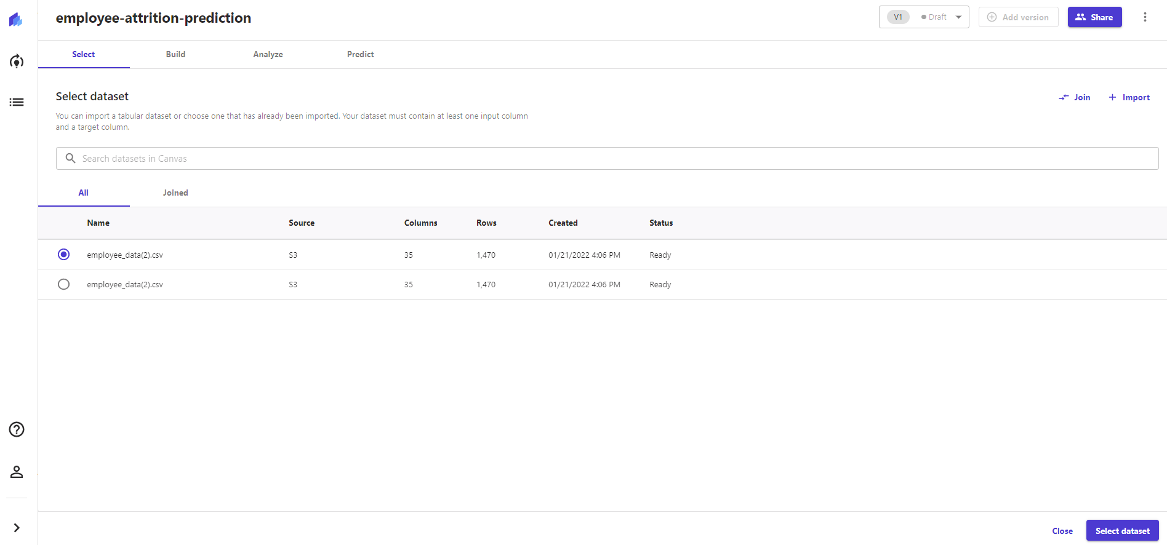
AWS SAGEMAKER CANVAS
SELECT THE DATASET

Slide 23
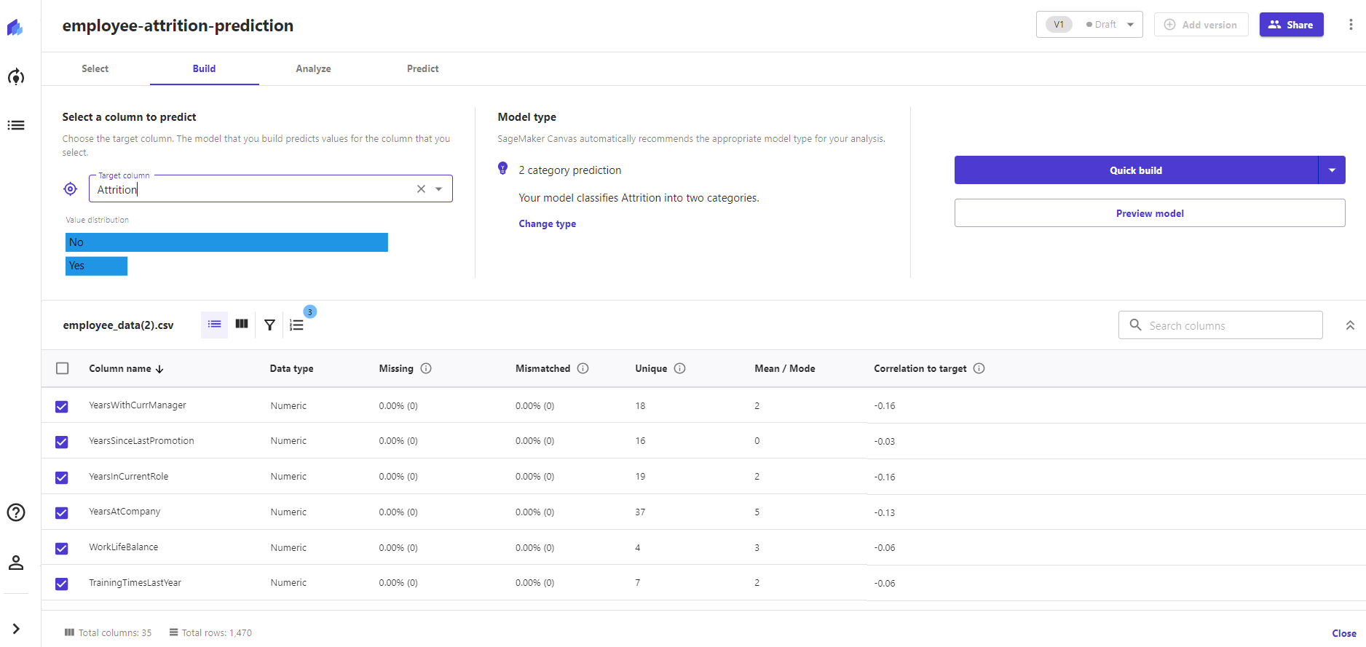
AWS SAGEMAKER CANVAS
SELECT THE TARGET COLUMN “ATTRITION”, CLICK ON “QUICK MODEL”

Slide 24
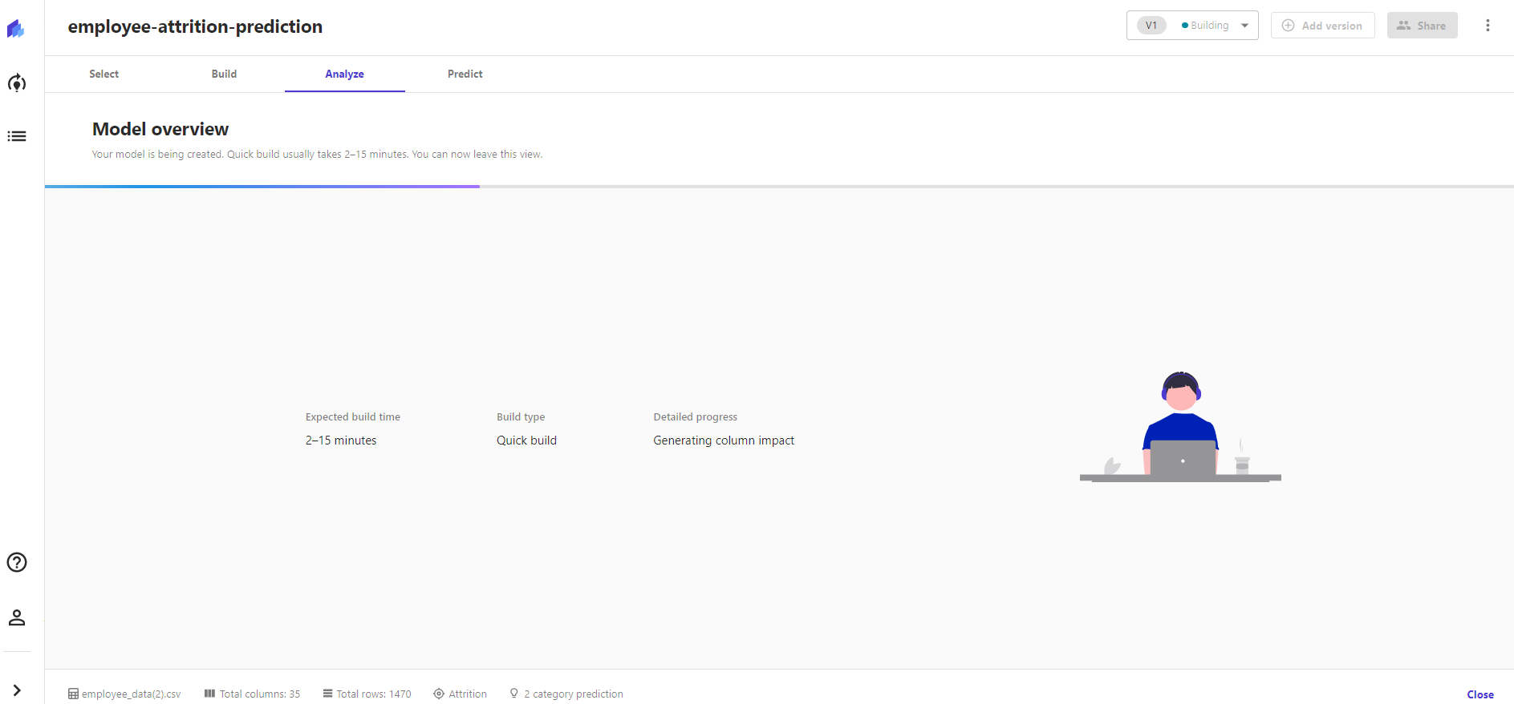
AWS SAGEMAKER CANVAS
QUICK MODEL TRAINING SHOULD TAKE 2-15 MINS TO TRAIN

Slide 25
DEMO PART 3: TRAINED MODEL ASSESSMENT
EASY
ADVANCED

Slide 26
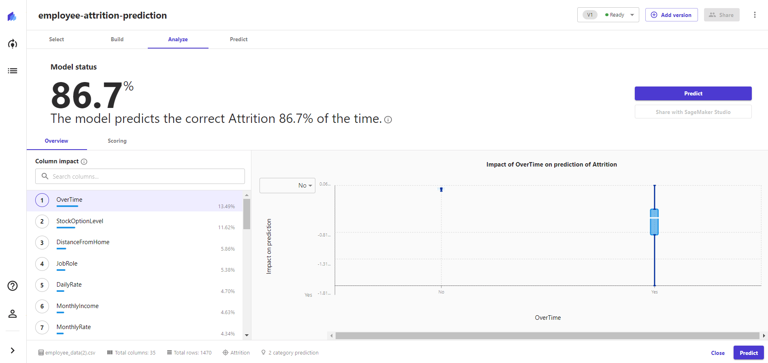
AWS SAGEMAKER CANVAS
AFTER THE MODEL IS TRAINED, IT’S NOW READY TO BE ANALYZED! CHECK OUT THE FEATURE IMPORTANCE (IMPACT)

Slide 27
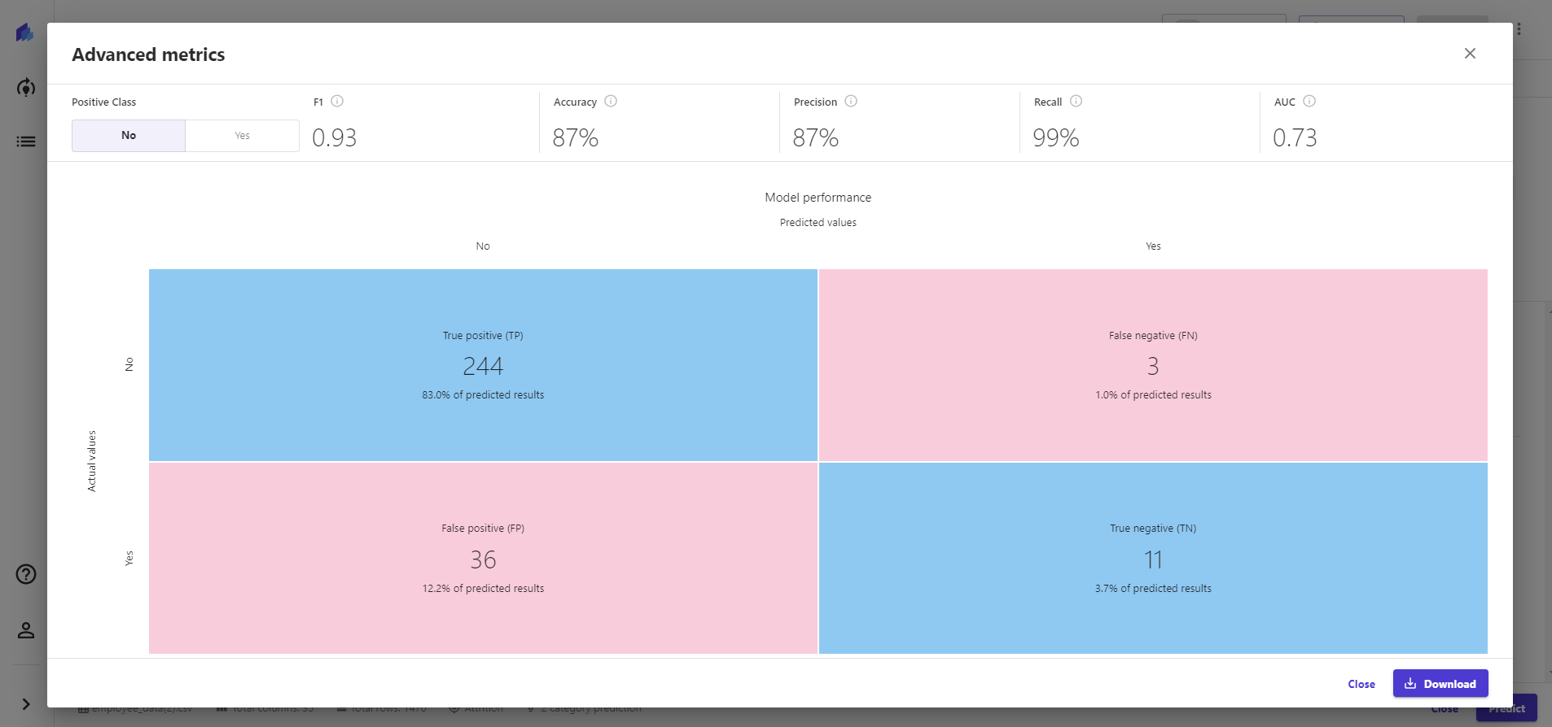
AWS SAGEMAKER CANVAS
CONFUSION MATRIX

Slide 28
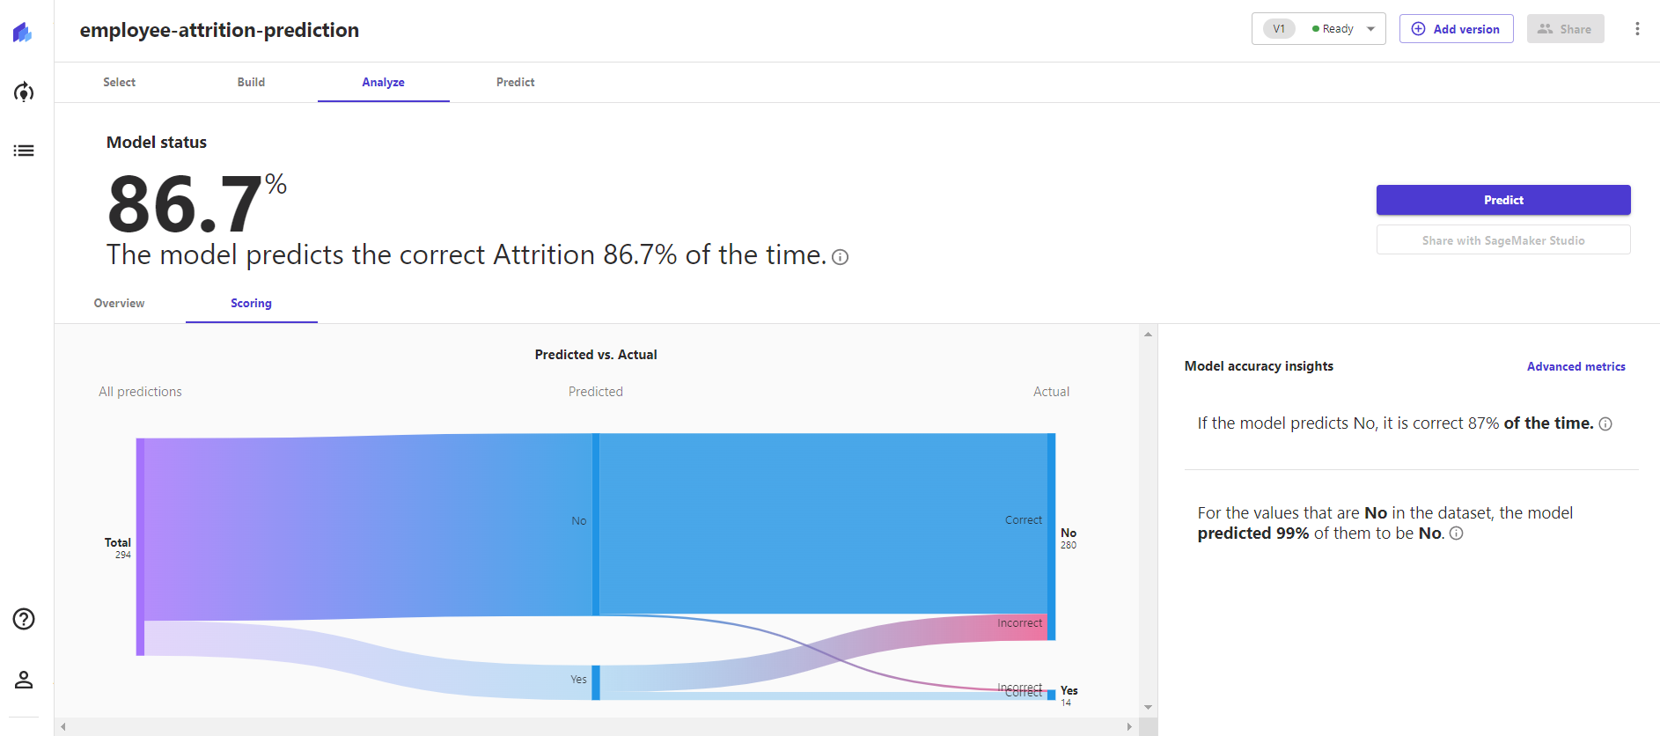
AWS SAGEMAKER CANVAS

Slide 29
DEMO PART 4: PERFORM MODEL INFERENCE
EASY
ADVANCED

Slide 30

AWS SAGEMAKER CANVAS
SELECT INPUTS AND GENERATE OUTPUT

Slide 31
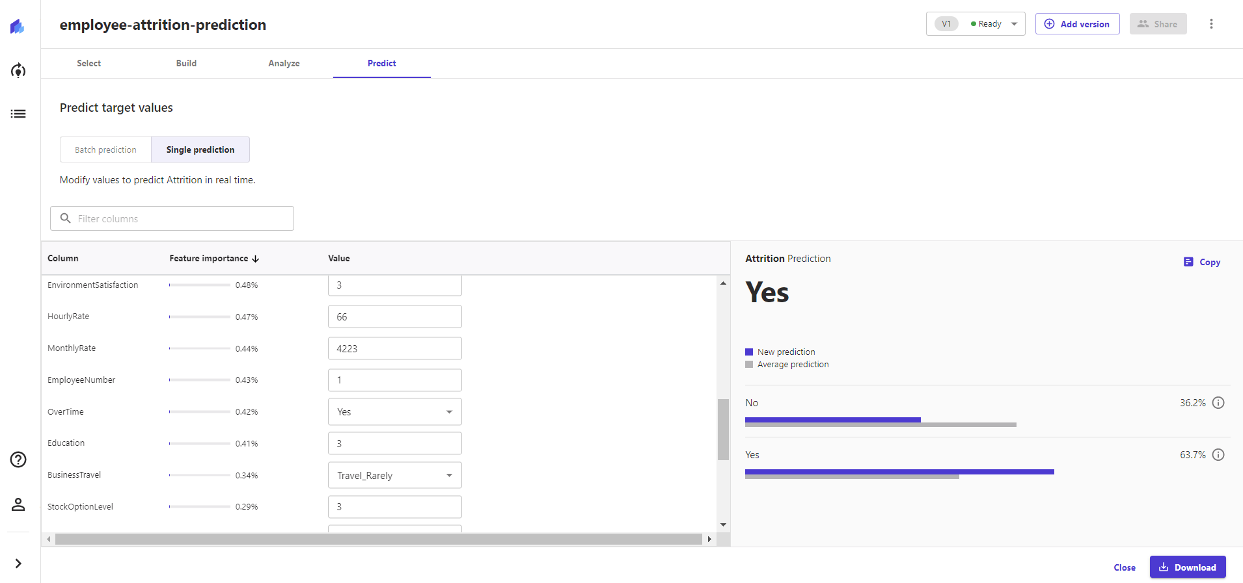
AWS SAGEMAKER CANVAS
UPDATE THE OVERTIME AND CLICK UPDATE

Slide 32
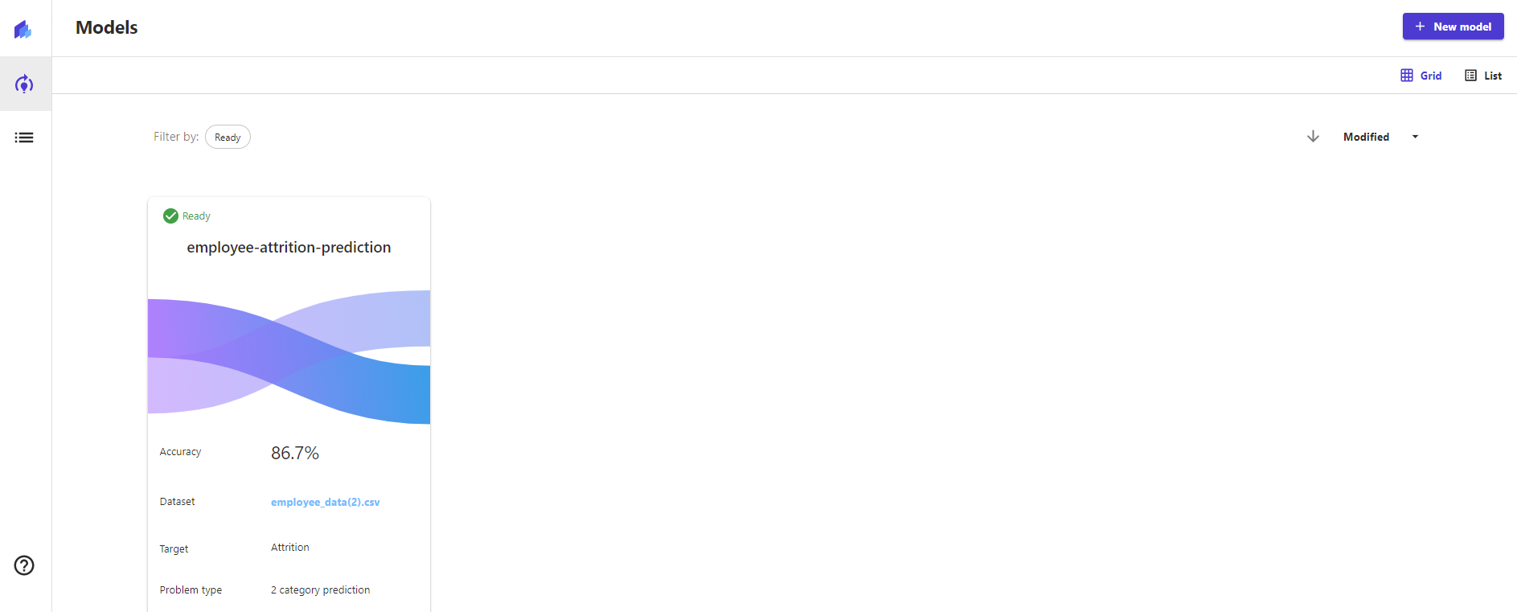
AWS SAGEMAKER CANVAS
YOU SHOULD SEE THE TRAINED MODEL UNDER THE MODELS TAB

Slide 33
FINAL END-OF-DAY CAPSTONE PROJECT
EASY
ADVANCED

Slide 34
PROJECT
Using AWS SageMaker Canvas, perform the following tasks:
1. Upload the “used_car_price.csv” dataset to S3 (note that this datasets is a regression-type)
2. Perform basic data exploration
3. What is the average horsepower and its correlation to target?
4. Select the target column (MSRP)
5. Click on Preview model and list the estimated RMSE in $ values
6. List the 3 most important features in the datasets
7. Train a regression model using quick build option
8. Test the model using at least 3 single prediction values

Slide 35
CLASSIFIER MODEL KEY PERFORMANCE INDICATORS (KPIs) – REVIEW
EASY
ADVANCED

Slide 36
CONFUSION MATRIX
TRUE CLASS
+
-
TYPE I ERROR
+
TRUE +
FALSE +
PREDICTIONS
FALSE -
TRUE -
-
TYPE II ERROR

Slide 37
CLASSIFICATION MODEL KPIs
A confusion matrix is used to describe the performance of a classiﬁcation model:
True positives (TP): cases when classiﬁer predicted TRUE (they have the disease), and correct class was TRUE (patient has disease).
True negatives (TN): cases when model predicted FALSE (no disease), and correct class was FALSE (patient do not have disease).
False positives (FP) (Type I error): classiﬁer predicted TRUE, but correct class was FALSE (patient did not have disease).
False negatives (FN) (Type II error): classiﬁer predicted FALSE (patient do not have disease), but they actually do have the disease
Classiﬁcation Accuracy = (TP+TN) / (TP + TN + FP + FN)
Misclassiﬁcation rate (Error Rate) = (FP + FN) / (TP + TN + FP + FN)

Slide 38
PRECISION Vs. RECALL
Precision = TP/Total TRUE Predictions = TP/ (TP+FP) (When model predicted TRUE class, how often was it right?)
Recall = TP/ Actual TRUE = TP/ (TP+FN) (when the class was actually TRUE, how often did the classiﬁer get it right?)
TRUE CLASS
+
-
+
TRUE +
FALSE +
PREDICTIONS
FALSE -
TRUE -
-

Slide 39
PRECISION Vs. RECALL
TRUE CLASS
FACTS:
100 PATIENTS TOTAL
91 PATIENTS ARE HEALTHY
9 PATIENTS HAVE CANCER
+
-
Accuracy is generally misleading and is not enough to assess the performance of a classifier.
Recall is an important KPI in situations where:
Dataset is highly unbalanced; cases when you have small cancer patients compared to healthy ones.
TP = 1
FP = 1
+
PREDICTIONS
-
FN = 8
TN = 90
Classiﬁcation Accuracy = (TP+TN) / (TP + TN + FP + FN) = 91%
Precision = TP/Total TRUE Predictions = TP/ (TP+FP) = ½=50%
Recall = TP/ Actual TRUE = TP/ (TP+FN) = 1/9 = 11%

Slide 40
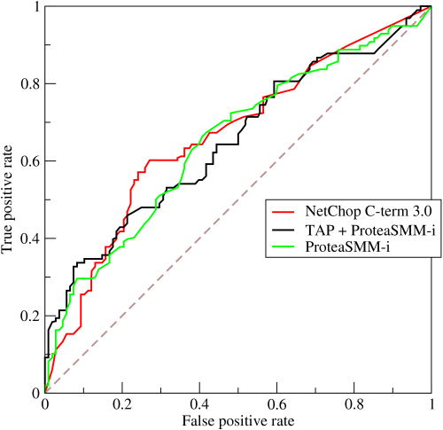
ROC (RECEIVER OPERATING CHARACTERISTIC CURVE)
ROC Curve is a metric that assesses the model ability to distinguish between binary (0 or 1) classes.
The ROC curve is created by plotting the true positive rate (TPR) against the false positive rate (FPR) at various threshold settings.
The true-positive rate is also known as sensitivity, recall or probability of detection in machine learning.
The false-positive rate is also known as the probability of false alarm.
Points above the diagonal line represent good classification (better than random)
The model performance improves if it becomes skewed towards the upper left corner.
Photo Credit: https://commons.wikimedia.org/wiki/File:Roccurves.png

Slide 41
AUC (AREA UNDER CURVE)
PREDICTOR #1
The light blue area represents the area Under the Curve of the Receiver Operating Characteristic (AUROC).
The diagonal dashed red line represents the ROC curve of a random predictor with AUROC of 0.5.
If ROC AUC = 1, perfect classifier
Predictor #1 is better than predictor #2
Higher the AUC, the better the model is at predicting 0s as 0s and 1s as 1s.
PREDICTOR #2
TRUE POSITIVE RATE
RANDOM PREDICTOR
FALSE POSITIVE RATE

